Slide 1
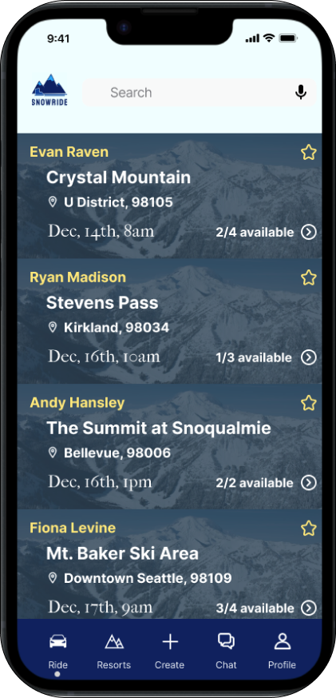

SNOWRIDE
A platform for skiers to find a ride and get to the destination safely

Slide 2



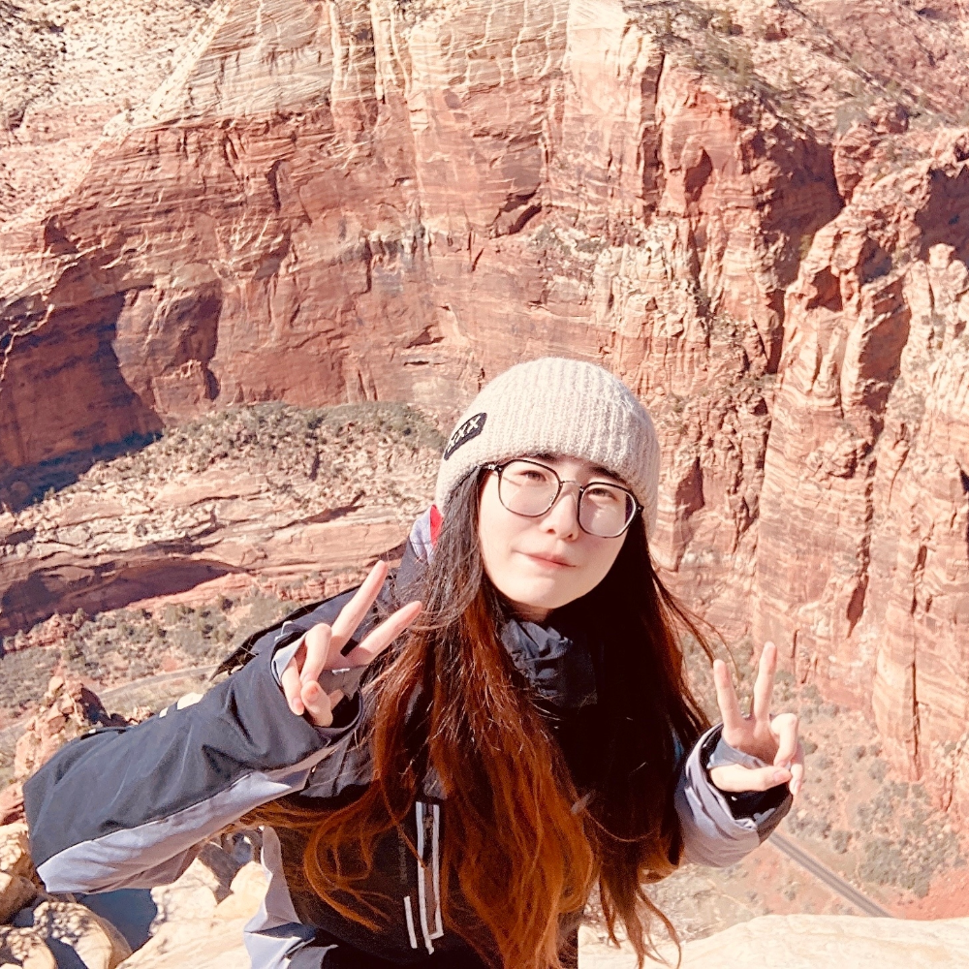

Team Intro
Dexin Sun
User Testing Lead
Sunny Zheng
User Experience Lead
Selina Sun
Research Lead
Fatima Dineh
Design Lead
Notes:
Fatima

Slide 3
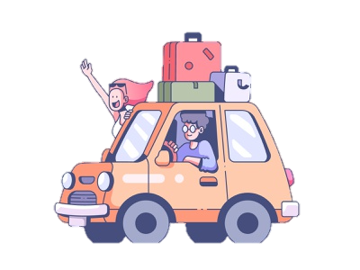

Context
Transportation is one of the main barriers for people who want to go skiing or snowboarding
There are nearly no ride-sharing platforms and public transportation options
1
3
2
Skiers who don’t have access to cars have to depend on others’ availability
Notes:
Fatima:
For context we realized that transportation was a problem if you didn’t have a ride and you would have to depend on others only if they were available. There isn’t a platform where you can rideshare for skiing or snowboarding.

Slide 4
Problem Statement
How might skiers who need a ride achieve finding a ride with other skiers nearby so that they can go to the destination when they want to go?
Notes:
Fatima

Slide 5
Key research insights
Majority of the skiers usually need a ride to the mountains and want to share rides with people with similar skills and interests
Riders tend to have concerns over safety, both on the road and on the mountains
1
3
2
Incentives for drivers to give a ride includes sharing gas prices and making new friends
People worry about information security and need their information to be protected
4
Notes:
From research we found that most skiers usually need a ride to the mountains and they prefer people with similar interests and skills to share a ride
And for the drivers, in order for them to be willing to give out a ride, there must be some incentives such as to have the gas prices splitted and providing them an opportunity to make new friends
Lastly, we found that the main concerns for people sharing a ride to the mountains are twofold: they worry about both safety on and off the mountains and also their information security

Slide 6


Target Personas
Vanessa
Age: 20
Gender: Female and Student
Education Level: Second Year College Student
Work: Part-time at school
Needs: Vanessa doesn't have a car, and she has time conflict with her skier friends, so she need a ride to the ski resort
Tom
Age: 25
Gender: Male and Single
Education Level: College Degree
Work: Computer Programmer
Needs: Tom loves skiing but has no friends to go skiing with. He has a car and he wants to make more skiing friends
Vinny Viewer
Notes:
Vanessa 20 female sophomore in college. No car She really wants to go skiing but she could not make it by her own.
tom 25 male . he loves skiing but he has no friends to go with. He has a car and wants to make more friends.

Slide 7
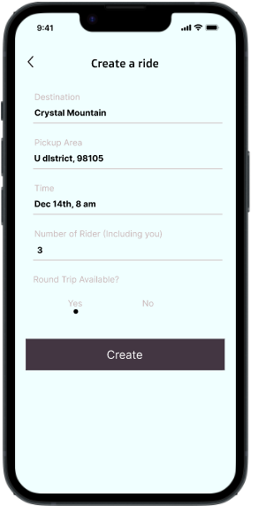
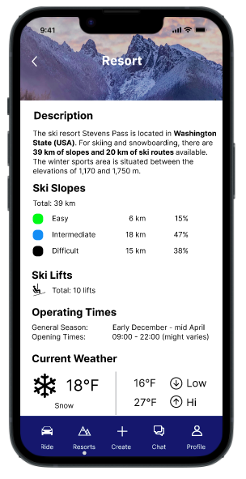
Key
Features
Create Rides:
Drivers can enter pickup time, address and number of available seats
Resorts Info:
Find real-time information of each ski resort
Notes:
To help skiers get to the destination, we created SNOWRIDE.
If you are a driver, you can create a ride by entering the destination, pickup area, time, and other detailed information. If you are a rider, you can go to the resort tap to view each resort’s information and real-time condition and decide your destination.

Slide 8
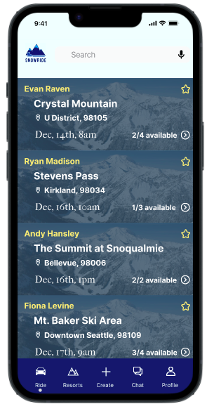
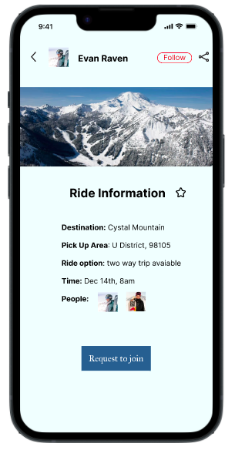
Join Rides:
Riders can join rides based on their preference
Find Rides:
Riders can find different rides and click on the arrow to join the ride they like
Notes:
Then on the ride page, the rider can browse different rides that is available to join. They can click on the individual card to view the detailed information about the ride, view other group mates’ profile page and click the request button if they decided to join. The driver will receive the request and make their decisions.

Slide 9
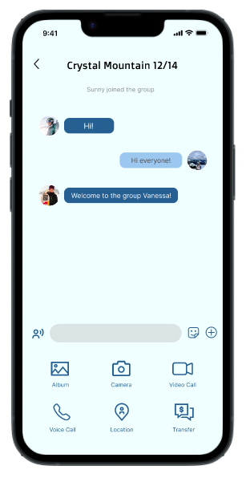
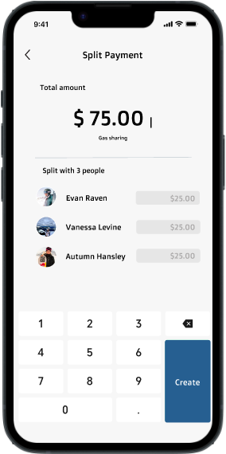
Transfer:
Skiers can split gas prices and transfer money
Notes:
After joining the group, SNOWRIDE will create a group chat for the group to communicate. To ensure safety on and off the mountain, users can choose to turn on their real-time location for other member’s to track. And the transfer function can help driver to split gas money and riders can easily make the transfer.

Slide 10
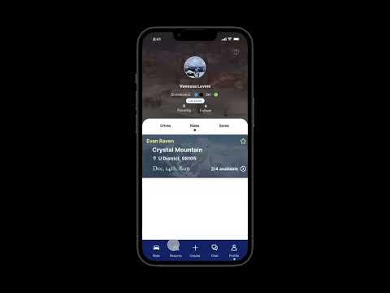
Notes:
Now we will show you the demo video of our user using SNOWRIDE.

Slide 11

CHALLENGES
NEXT STEPS
Ensure the app can address users’ need of getting a ride while providing other services that they might need
Research about people’s need for forming a ski community and develop social features if applicable
1
1
2
Developing features that protects user privacy and information security
More features ensuring the safety of users and providing customer support
2
Notes:
During the project, we encounter some challenges with understanding the users’ need throughout the process of getting the ride and also creating relevant features to have users’ privacy and information security protected.
For our next steps, we plan to research whether people want to socialize within the ride-sharing process and provide more customer support. We want our users to have a smooth ride experience and potentially welcome more people into skiing and snowboarding by using SnowRide.
Thank you and we are open to any questions or feedbacks!

Slide 12

Thank You!

